Slide 1



Rat Dissection
The following
slides are
intended to help
you with dissection
of the rat and then
to review for the lab practical that will follow.

Slide 2
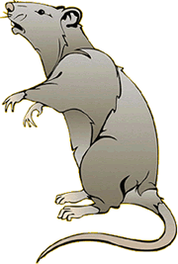

Rat Dissection
RATS
Scientific Name:
Rattus norvegicus
Common Name: Rat
Kingdom- Animalia
Phylum- Chordata
Subphylum- Vertebrata
Class- Mammalia
Order- Rodentia
Notes:
http://dcfud.smorgasblog.com/userimages/rat.bmp
http://www.gisbornesc.vic.edu.au/home/jans/home/rat.htm

Slide 3
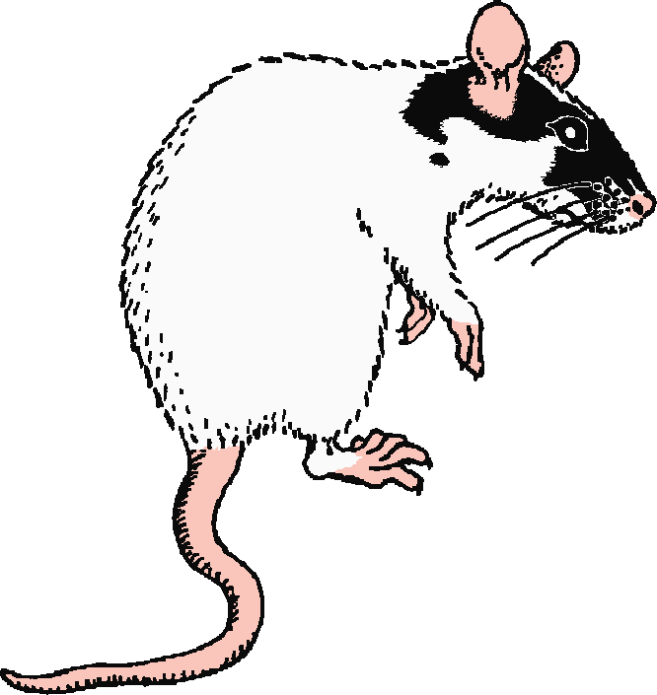
Rat Dissection
SOURCES
The following web sites were used to obtain various dissection pictures.
(1) http://www.umanitoba.ca/faculties/science/biological_sciences/lab_x000b_15/biolab15_1.html
(2) http://www.gisbornesc.vic.edu.au/home/jans/home/rat.htm
(3) http://www.biologycorner.com/bio3/rat_guide.html
(4) http://www.biologymad.com/ratphotos/ratphotos.htm
(5) http://www.baa.duke.edu/companat/BAA_289L_2004/heart/Rat/rat_thorax.htm
(6) http://instruct1.cit.cornell.edu/courses/biog105/images/ratpics/unit6/
(7) http://www.victoriacollege.edu/dept/bio/RatDissection/index.htm
This has an excellent self quiz!
Urogenital Tutorial- http://www.biolsci.monash.edu.au/undergrad/erat/index.html
Notes:
http://www.biologycorner.com/bio3/rat_guide.html

Slide 4
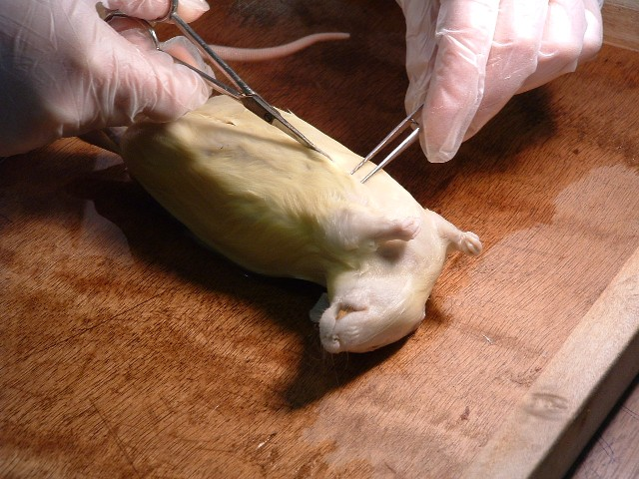
Rat Dissection
REMOVING SKIN
Source #4

Slide 5
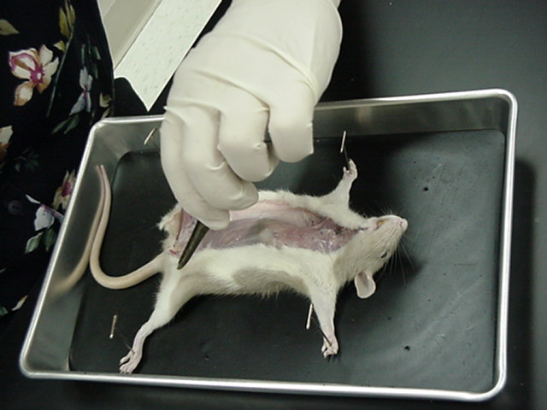
Rat Dissection
REMOVING SKIN
Source #7

Slide 6
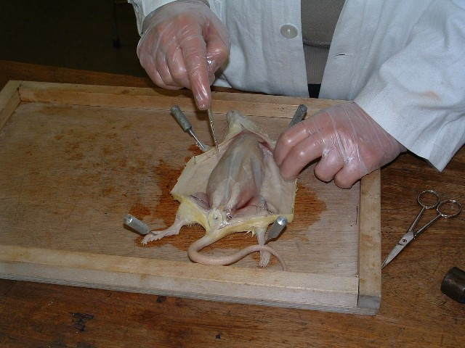
Rat Dissection
REMOVING SKIN
Source #4

Slide 7
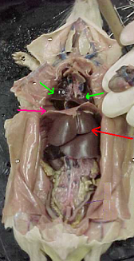
BODY CAVITIES
Rat Dissection
1. The DIAPHRAGM Divides the ventral cavity into:
2. THORACIC CAVITY
heart & lungs
3. ABDOMINAL CAVITY
digestive, excretory, reproductive organs
2.
1.
3.

Slide 8
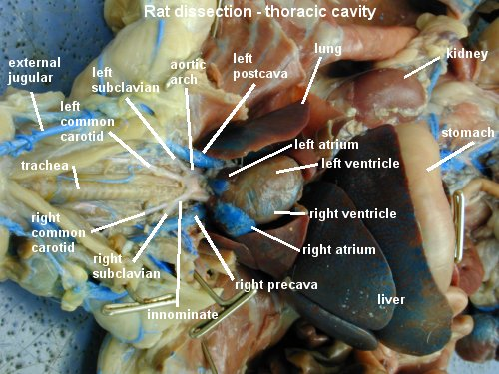
Rat Dissection
THORACIC CAVITY
Source #1
Notes:
http://kentsimmons.uwinnipeg.ca/16cm05/16labman05/lb8pg12.htm

Slide 9
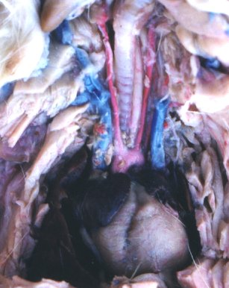
HEART + BLOOD VESSELS
Rat Dissection
Trachea
Right Superior Vena Cava
Left Superior Vena Cava
Aorta
Atrium
Heart (Ventricles)

Slide 10
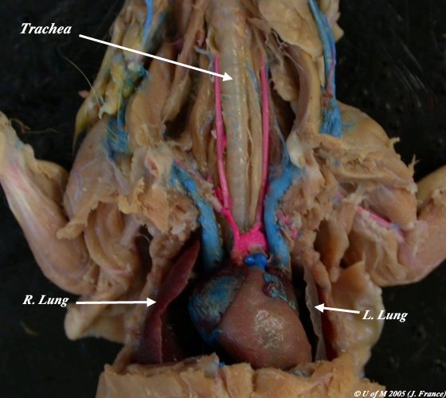
Rat Dissection
RESPIRATORY ORGANS
Source #1

Slide 11
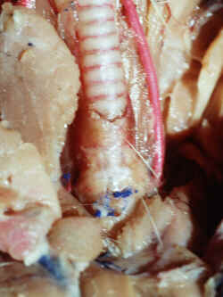
Rat Dissection
RESPIRATORY ORGANS
Trachea
Cartilage rings

Slide 12
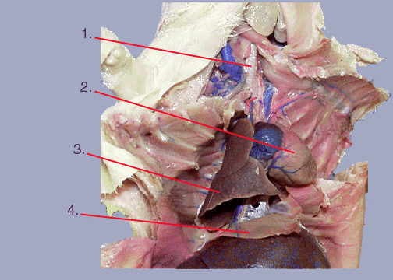
Rat Dissection
THORACIC ORGANS
Trachea
Heart (Ventricles)
Right Lung
Diaphragm

Slide 13
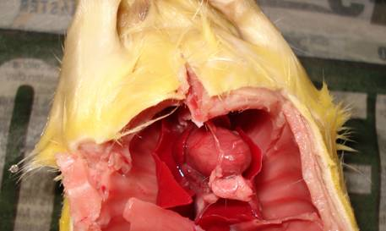
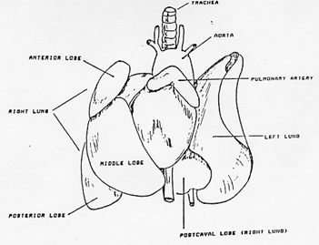
Rat Dissection
RESPIRATORY ORGANS
Right Lung
Left Lung

Slide 14
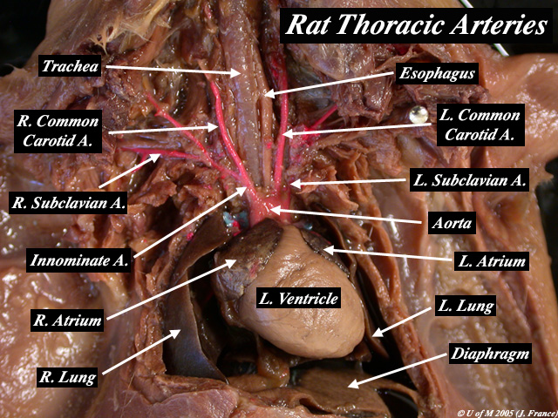
Rat Dissection
CIRCULATORY ORGANS
Source #1

Slide 15
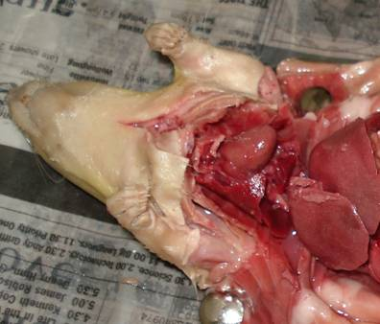
Rat Dissection
HEART
Heart

Slide 16
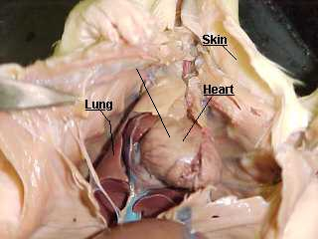
THORACIC
ORGANS
Rat Dissection
Thymus Gland
Heart
Right Atrium
Ventricles

Slide 17
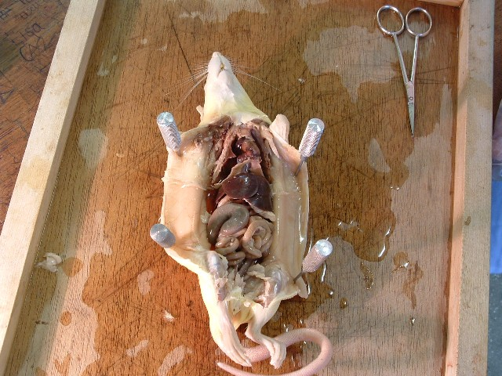
Rat Dissection
ABDOMINAL CAVITY
Source #4

Slide 18
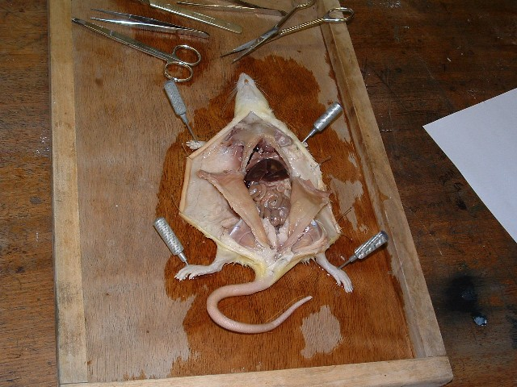
Rat Dissection
ABDOMINAL CAVITY
Source #4

Slide 19
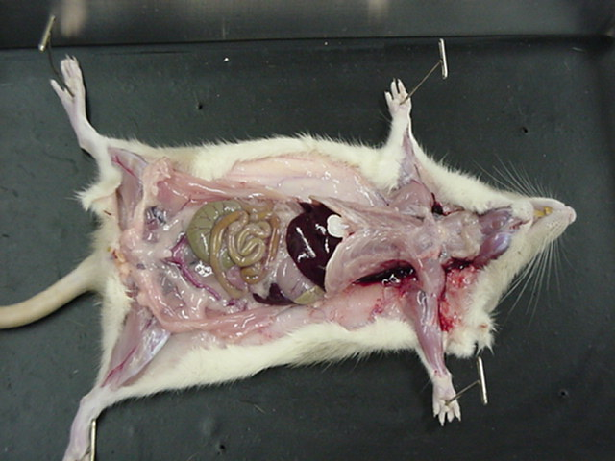
Rat Dissection
ABDOMINAL CAVITY
Source #7

Slide 20
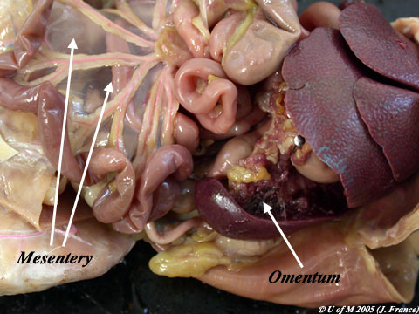
Rat Dissection
DIGESTIVE
ORGANS
Source #1

Slide 21
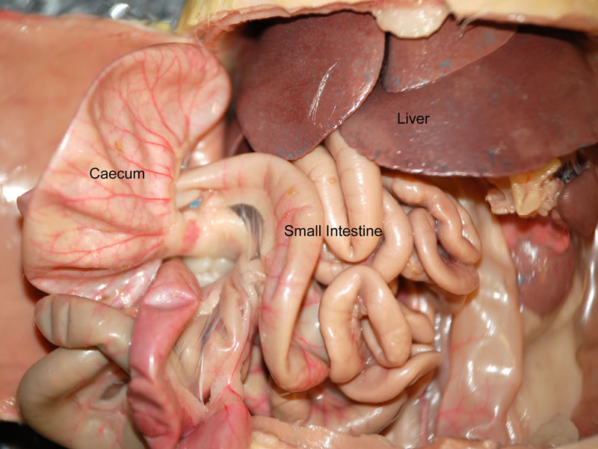
Rat Dissection
DIGESTIVE
ORGANS
Source #6

Slide 22
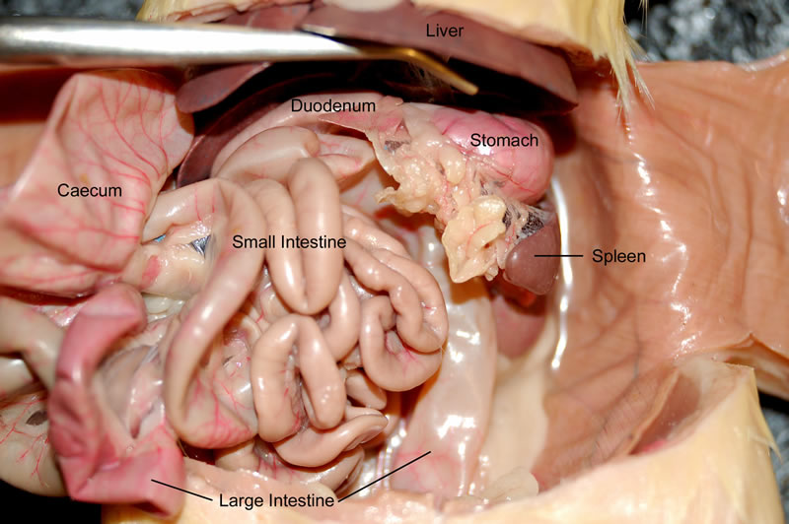
Rat Dissection
DIGESTIVE
ORGANS
Source #6

Slide 23
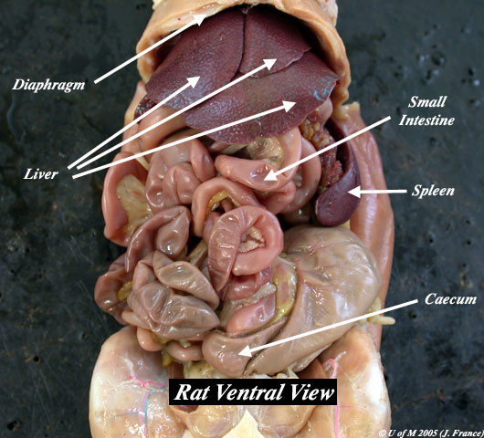
Rat Dissection
DIGESTIVE
ORGANS
Source #1

Slide 24
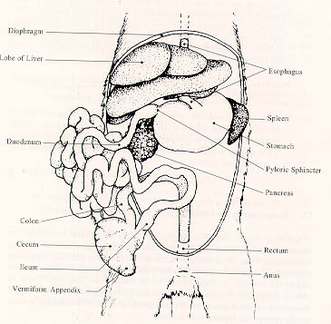
DIGESTIVE
ORGANS
Rat Dissection

Slide 25
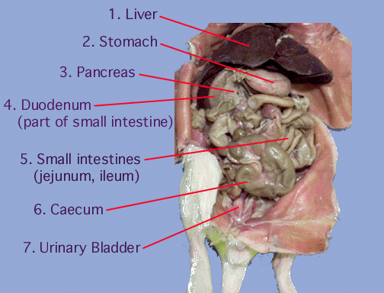
DIGESTIVE
ORGANS
Rat Dissection

Slide 26
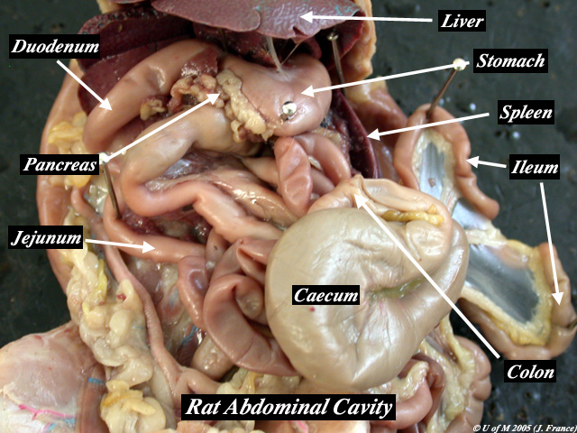
Rat Dissection
DIGESTIVE
ORGANS
Source #1

Slide 27
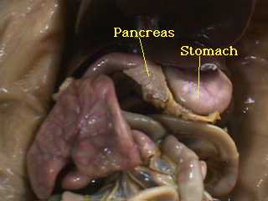
Rat Dissection
DIGESTIVE
ORGANS

Slide 28
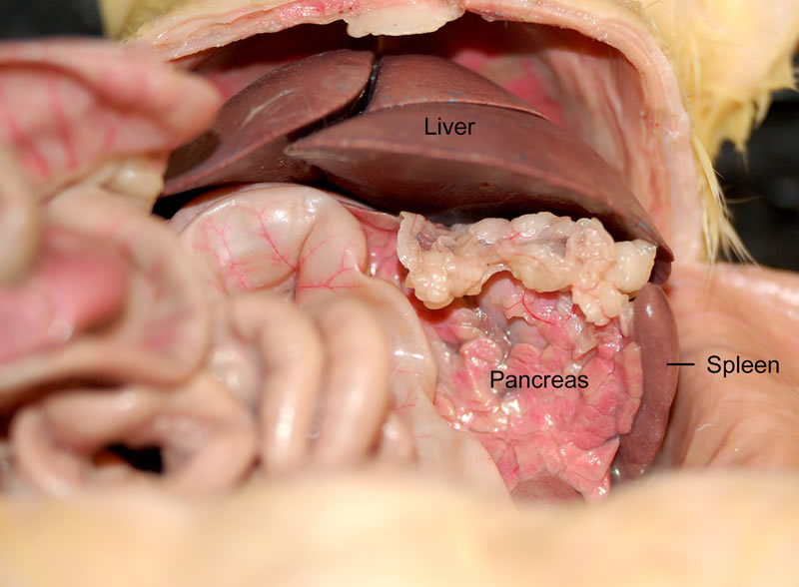
Rat Dissection
DIGESTIVE
ORGANS
Source #6

Slide 29
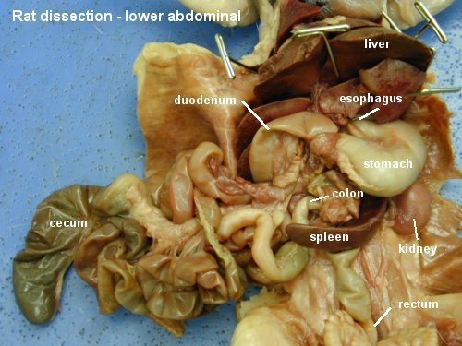
DIGESTIVE
ORGANS
Rat Dissection

Slide 30
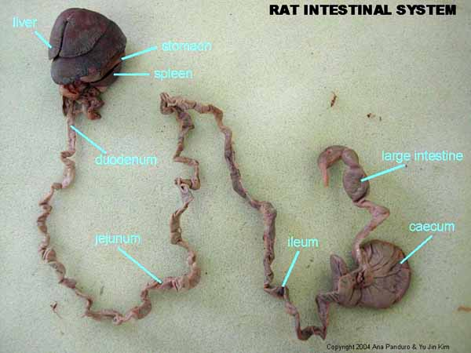
DIGESTIVE
ORGANS
Rat Dissection
Small Intestine

Slide 31
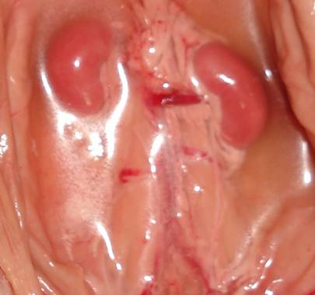
Rat Dissection
EXCRETORY ORGANS
Kidneys
Ureter

Slide 32
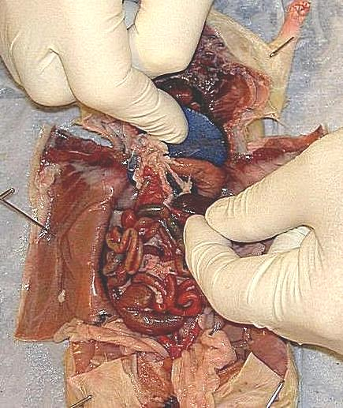
Rat Dissection
ORGANS
Liver
Stomach
Pancreas
Spleen
Small
Intestine
6. Cecum
7. Large
Intestine
1.
3.
2.
4.
5.
7.
6.

Slide 33
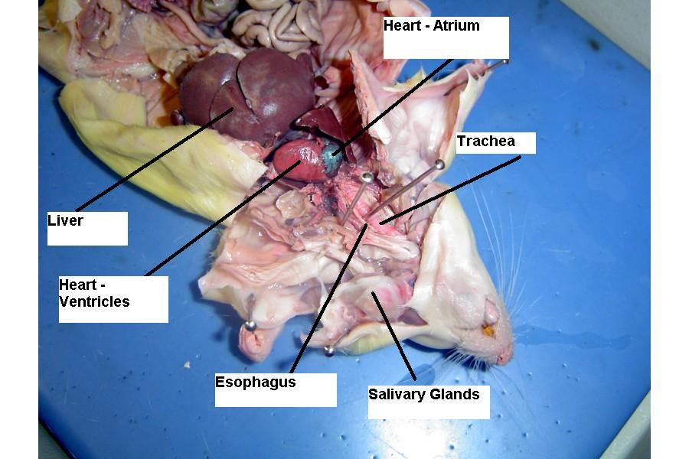
Rat Dissection
ORGANS

Slide 34
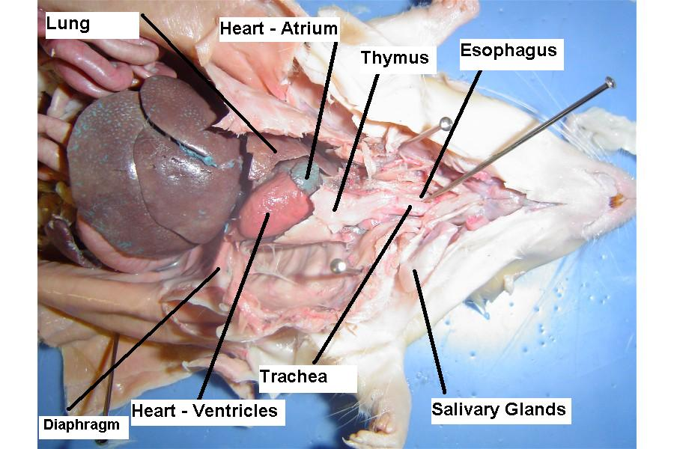
Rat Dissection
ORGANS

Slide 35
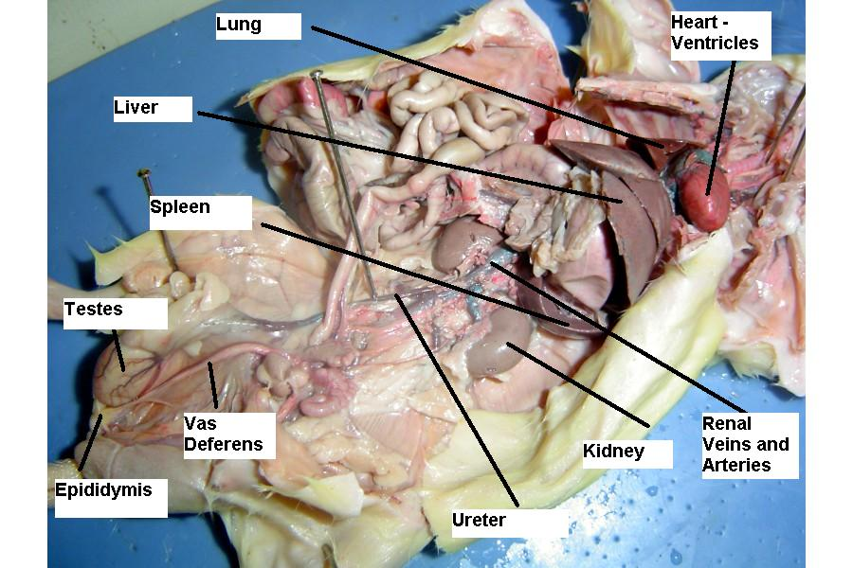
Rat Dissection
ORGANS

Slide 36
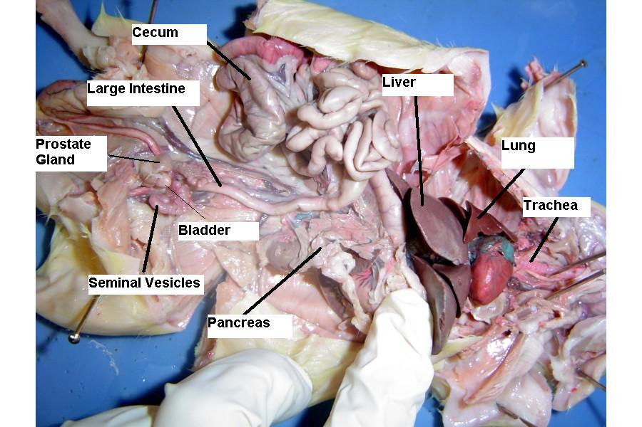
Rat Dissection
ORGANS

Slide 37
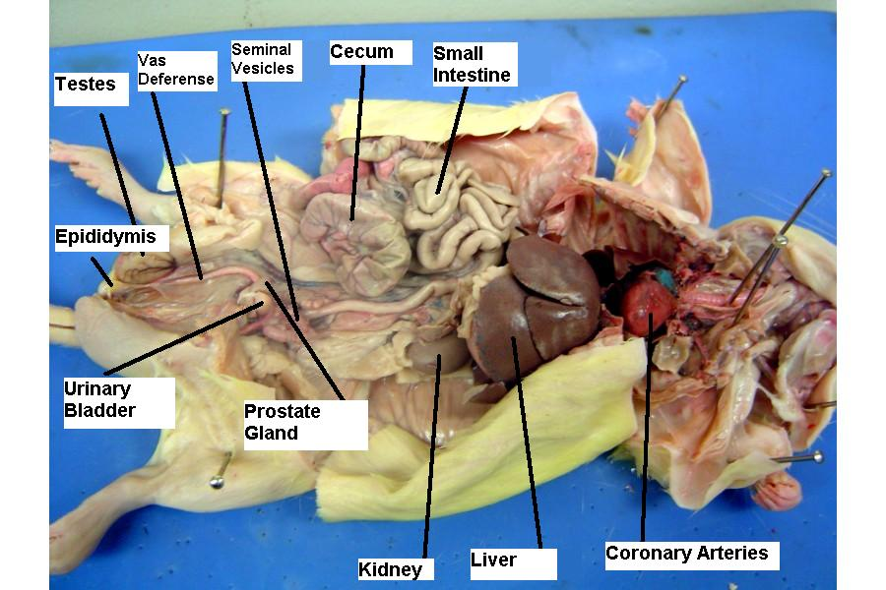
Rat Dissection
ORGANS

Slide 38
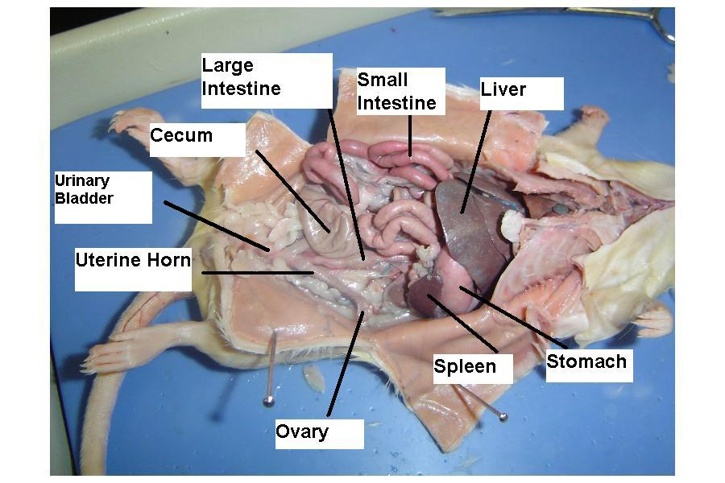
Rat Dissection
ORGANS

Slide 39
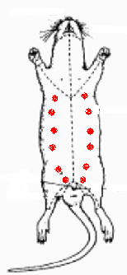
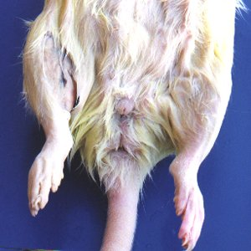
FEMALE
REPRODUCTIVE
ORGANS
Rat Dissection

Slide 40
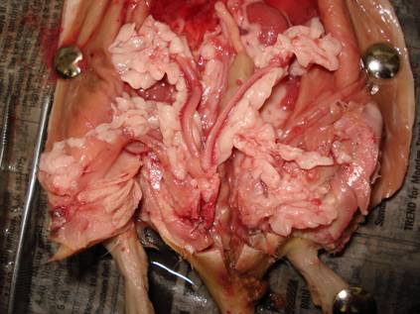
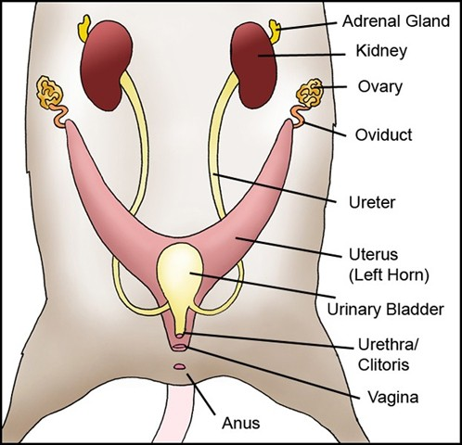
FEMALE
UROGENITAL ORGANS
Rat Dissection
Kidney
Ovary
Uterus (Left Horn)
Urinary Bladder

Slide 41
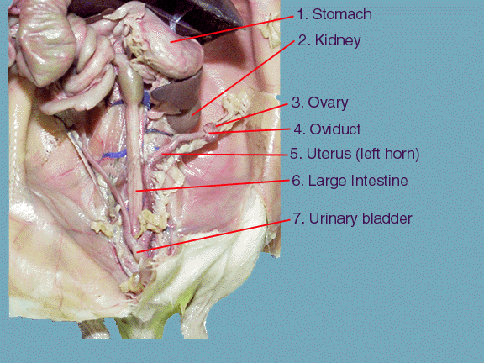
Rat Dissection
UROGENITAL ORGANS

Slide 42
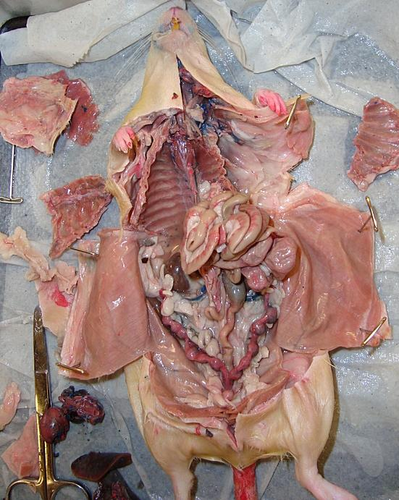
UROGENITAL ORGANS
Rat Dissection
Female Uterus
With developing
embryos

Slide 43
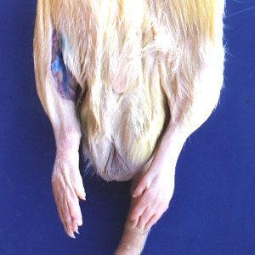
MALE
REPRODUCTIVE
ORGANS
Rat Dissection

Slide 44
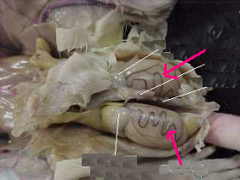
MALE
REPRODUCTIVE
ORGANS
Rat Dissection
Testis

Slide 45
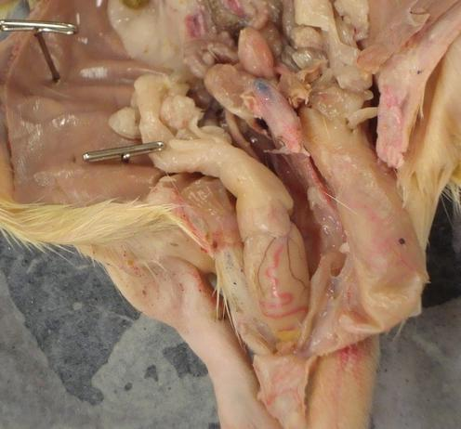
MALE
REPRODUCTIVE
ORGANS
Rat Dissection
Urinary Bladder
Penis
Testis

Slide 46
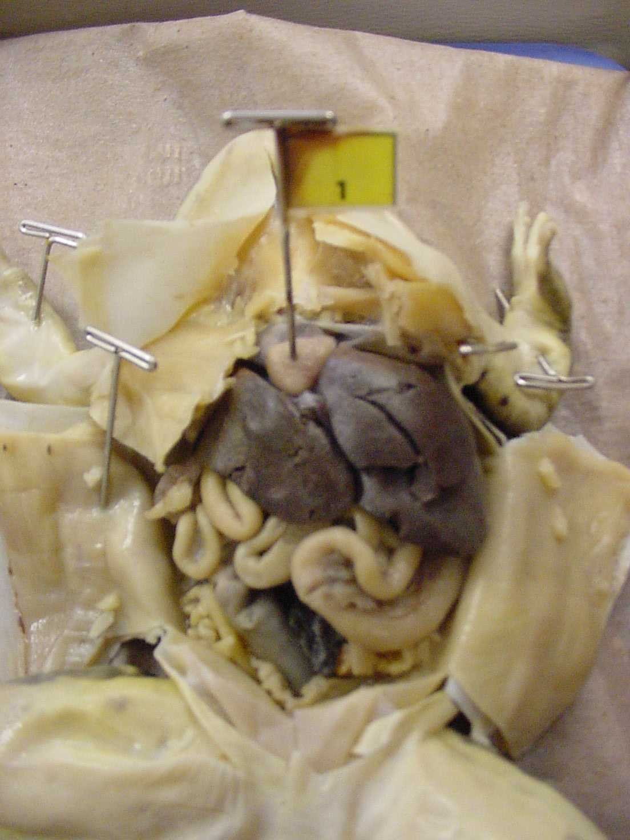
Review and Quiz Yourself
Rat Dissection
LAB TEST
The test is normally called a dissection “Practical”. This is how most dissection tests are given!
Pans of dissected rats are situated around the lab in strategic locations.
Each rat will have numbered pins stuck in various structures.
Questions will accompany the rat and the pins.
You MUST be sure to READ the questions as you look at the pins.

Slide 47
Review and Quiz Yourself
Rat Dissection
THORACIC CAVITY
Trachea
Heart
Lung
Diaphragm
Source #2

Slide 48
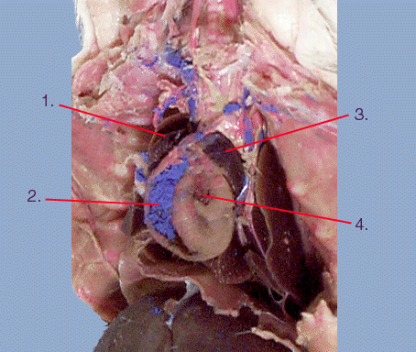
Review and Quiz Yourself
Rat Dissection
HEART
Right
Atrium
Right
Ventricle
Left Atrium
Left
Ventricle
Source #2

Slide 49
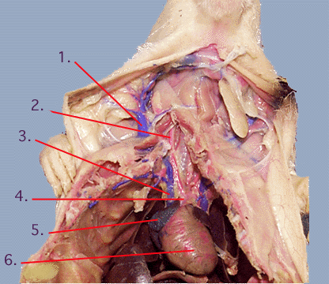
Review and Quiz Yourself
Rat Dissection
THORACIC CIRCULATION
Vein
Artery
Superior Vena Cava
Aorta
Atrium (right)
Ventricles
Source #2

Slide 50

Rat Dissection
ABDOMINAL CAVITY
You should be familiar with the order of the parts of the alimentary canal. Following the path that food would take, we would pass through:
  Oral Cavity
  Pharynx
  Esophagus
  Stomach
  Pyloric Sphincter
  Small Intestine
  Large Intestine
  Rectum
  Anus
Source #1

Slide 51

Review and Quiz Yourself
Rat Dissection
ABDOMINAL CAVITY
1. Liver
2. Stomach
3. Pancreas
5. Small
Intestines
6. Cecum
7. Urinary
Bladder
Source #2

Slide 52

Review and Quiz Yourself
Rat Dissection
MALE REPRODUCTIVE ORGANS
2. Urinary Bladder
3. Vas Deferens
4. Epididymis
5. Small Intestines
6. Seminal Vesicle
8. Penis
9. Testis
10.Scrotum
Source #2

Slide 53

Review and Quiz Yourself
Rat Dissection
FEMALE REPRODUCTIVE ORGANS
Stomach
Kidney
Ovary
Oviduct
Uterine Horn
Large Intestine
Urinary Bladder
Source #2

Slide 54

Review and Quiz Yourself
Rat Dissection
TAGGED ORGANS
5.
9.
22.
27.
Esophagus
Lung
Trachea
Heart
Source #7

Slide 55

Review and Quiz Yourself
Rat Dissection
TAGGED ORGANS
3.
7.
8.
11.
17.
18.
Diaphragm
Cecum
Liver
Ovary
Small Intestine
Spleen
Source #7

Slide 56

Review and Quiz Yourself
Rat Dissection
TAGGED ORGANS
24.
26.
Urinary Bladder
Uterine
Horn
Source #7

Slide 57

Review and Quiz Yourself
Rat Dissection
TAGGED ORGANS
6.
20.
23.
25.
26.
Kidney
Stomach
Ureter
20
Large Intestine
Uterine Horn
25
26
Source #7

